Slide 1
Association of the Female Athlete Triad Risk Assessment Stratification to the Development of Bone Stress Injuries in Collegiate Athletes
Tenforde et al. 2016
The American Journal of Sports Medicine
Notes:
Association of the Female Athlete Triad Risk Assessment Stratification to the Development of Bone Stress Injuries in Collegiate Athletes

Slide 2
Purpose and Participants
Using the Female Athlete Triad Risk Assessment, NCAA collegiate female athletes are classified into 3 categories: low-risk, moderate-risk, and high-risk to the predict these athletes susceptibility to bone stress injuries
A total of 323 NCAA collegiate female athletes that completed electronic pre-participation physical examination and dual-energy X-ray absorptiometry
239 out of 323 athletes with known oligomenorrhea/ amenorrhea status were assigned to low, moderate, and high risk

Slide 3
Protocol
NCAA female athletes participate in any 16 sports at Stanford University between 2008 and 2014
Invited to participate in a study collecting dual-energy X-ray absorptiometry scans to measure bone density and body composition
Before participation and required by the NCAA athletes must complete PPE which was then reviewed by two research assistants

Slide 4
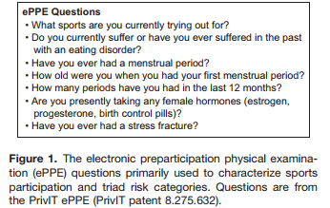
Exact ePPE Questions

Slide 5
Procedures
Those who eligible to participate in DXA scans, collected height and weight
Bone Mineral Density were analyzed in 3 regions: Total body, Lumbar Spine, and Dual Femur
Divided athletes into lean and nonlean sport groups
Lean: XC, Field Hockey, Gymnastics, Lacrosse, Rowing, Swimming/diving, Track and Field, and Water Polo
Nonlean: Basketball, Fencing, Sailing, Soccer, Softball, Tennis, Volleyball

Slide 6
Criterias for Low, Moderate, and High Risk
History or current disordered eating/ eating disorder
Age of menarche
History of oligomenorrhea/ amenorrhea in past 12 months
History of stress fractures or stress reactions
BMI values based on height and weight
Bone Mineral Density conducted by DXA scan

Slide 7
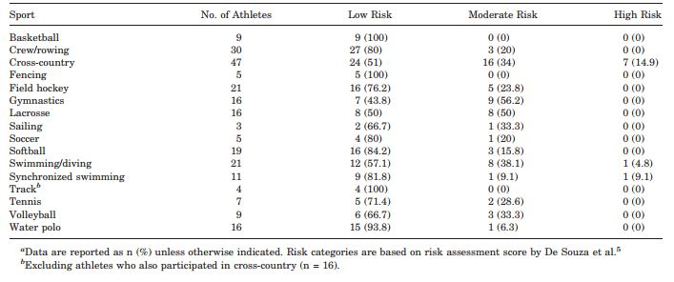
Data

Slide 8
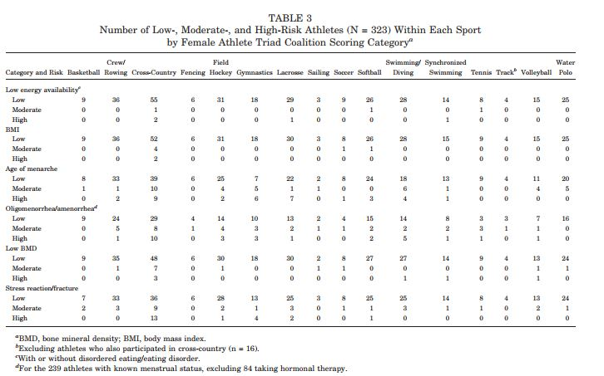

Slide 9
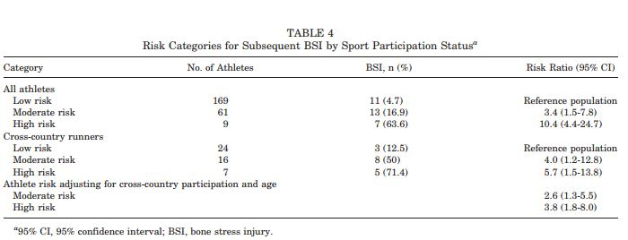
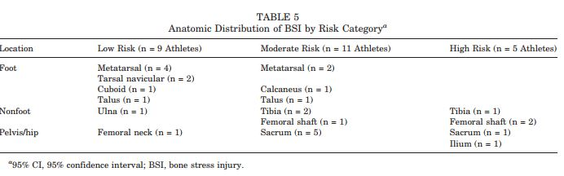

Slide 10
Statistics and Results
Average age: 20 years old
Nearly ¼ athletes had history of delayed menarche and the majority were lean-sport athletes
19 athletes have low bone mineral density and over ½ were cross country runners
Approximately 1 in 7 athletes had history of stress fractures/ stress reaction- most common in cross country, gymnastics, lacrosse, swiming,/ diving, and field hockey

Slide 11
Discussion
First priority- report the prevalence of athletes into the 3 categories and determine who are the athletes with elevated high risk
Findings corresponding with guideline recommendations for high risk athletes must receive active medical treatment, nutritional evaluation to reduce adverse health consequences
Identified sports that emphasizes leanness had the greatest proportion of athletes ranging from moderate to high risk

Slide 12
Limitations
Number of participants which only involved the female athlete population focused the majority of sample size on cross country runners
Athletes tend to underreport themselves
Could not fully account for multisport participation in the data and total athletic exposure risk for injury
For ex: cross country athletes who also run XC

Slide 13
References
Tenforde, A. S., Carlson, J. L., Chang, A., Sainani, K. L., Shultz, R., Kim, J. H., . . . Fredericson, M. (2016). Association of the Female Athlete Triad Risk Assessment Stratification to the Development of Bone Stress Injuries in Collegiate Athletes. The American Journal of Sports Medicine, 45(2), 302-310. doi:10.1177/0363546516676262

Slide 14
Thank you for your time
Any Questions!!!

